Slide 1
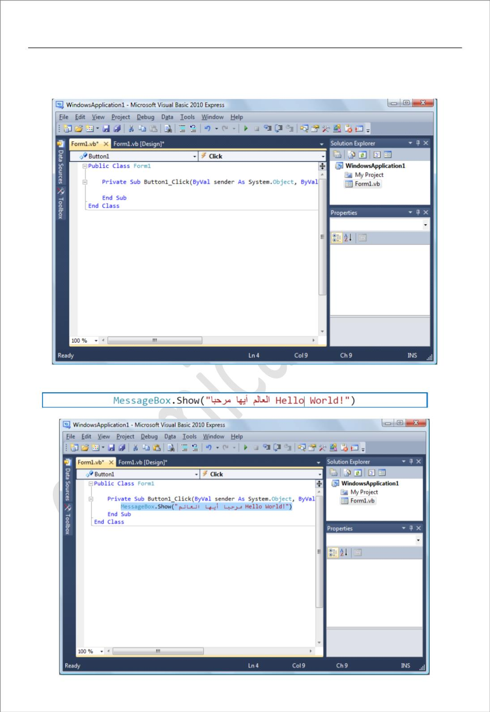
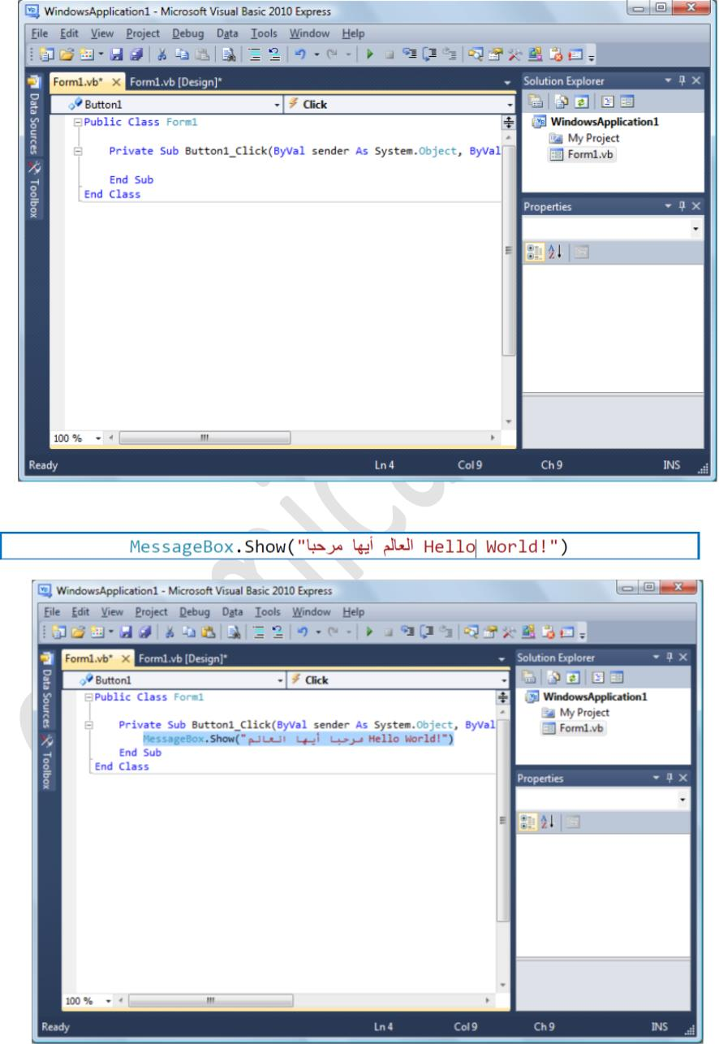
Assistant Lecturer
Visual Basic
university of Diyala /College of Engineering
Omar A. Imran
Department of Chemical
Second Class
2018 – 2019
codes على ꢃتحتو فذةꢂن كꢁ رꢀتظꢁ Double Click عليه اضغط -4
Trail Version
Trail Version
Trail Version
Trail Version
Trail Version
Trail Version
Trail Version
Trail Version
Trail Version
Trail Version
Trail Version
Trail Version
Trail Version
ودꢄꢁا ꢇꢈꢂتꢄ ꢆꢂꢄم ꢅف تبꢄا -5
11

Slide 2
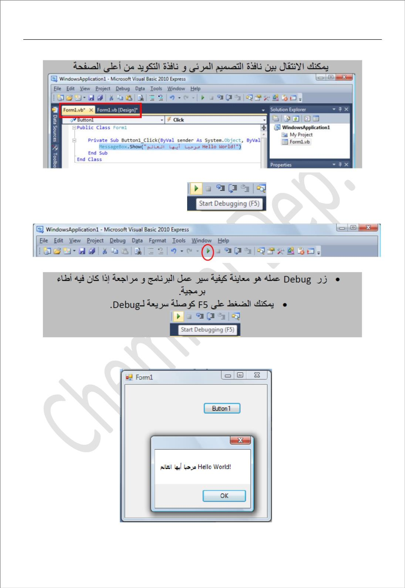
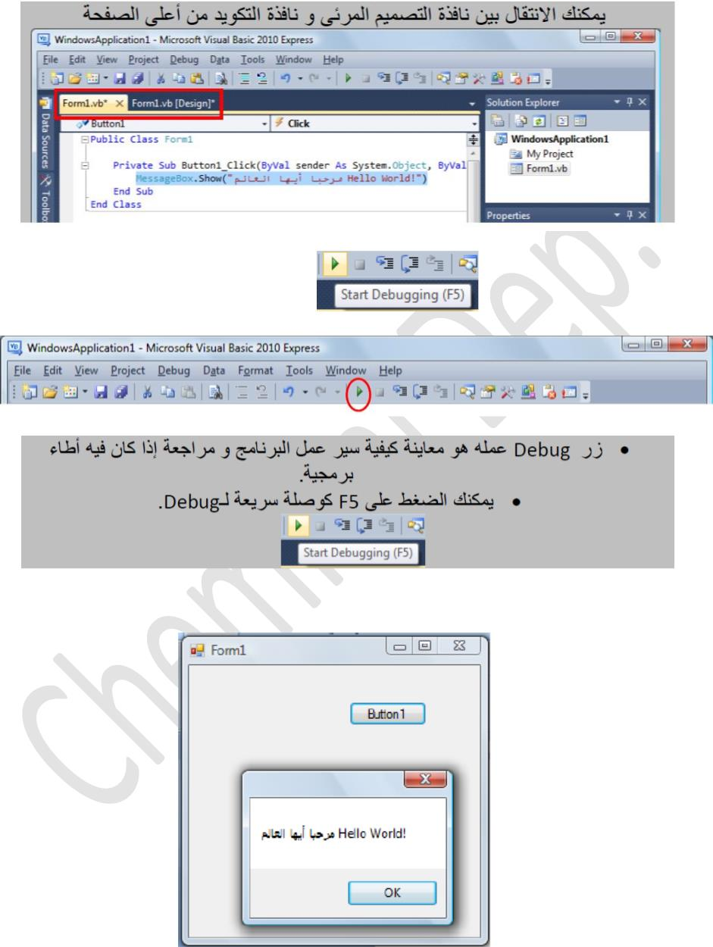
Assistant Lecturer
Visual Basic
university of Diyala /College of Engineering
Omar A. Imran
Department of Chemical
Second Class
2018 – 2019
.دواتꢁا طꢀشر في
Debug زر على اضغط -6
Trail Version
Trail Version
Trail Version
Trail Version
Trail Version
Trail Version
Trail Version
Trail Version
Trail Version
Trail Version
Trail Version
Trail Version
Trail Version
.موضح وꢄ ꢅمꢉ ꢈꢆꢅرس كꢆ ظهرꢂس Button 1 على اضغط ꢇث، ꢅهꢂصمم يꢂꢆا فذةꢅنꢆا ꢃذꢄ ظهرꢂس -7
12

Slide 3
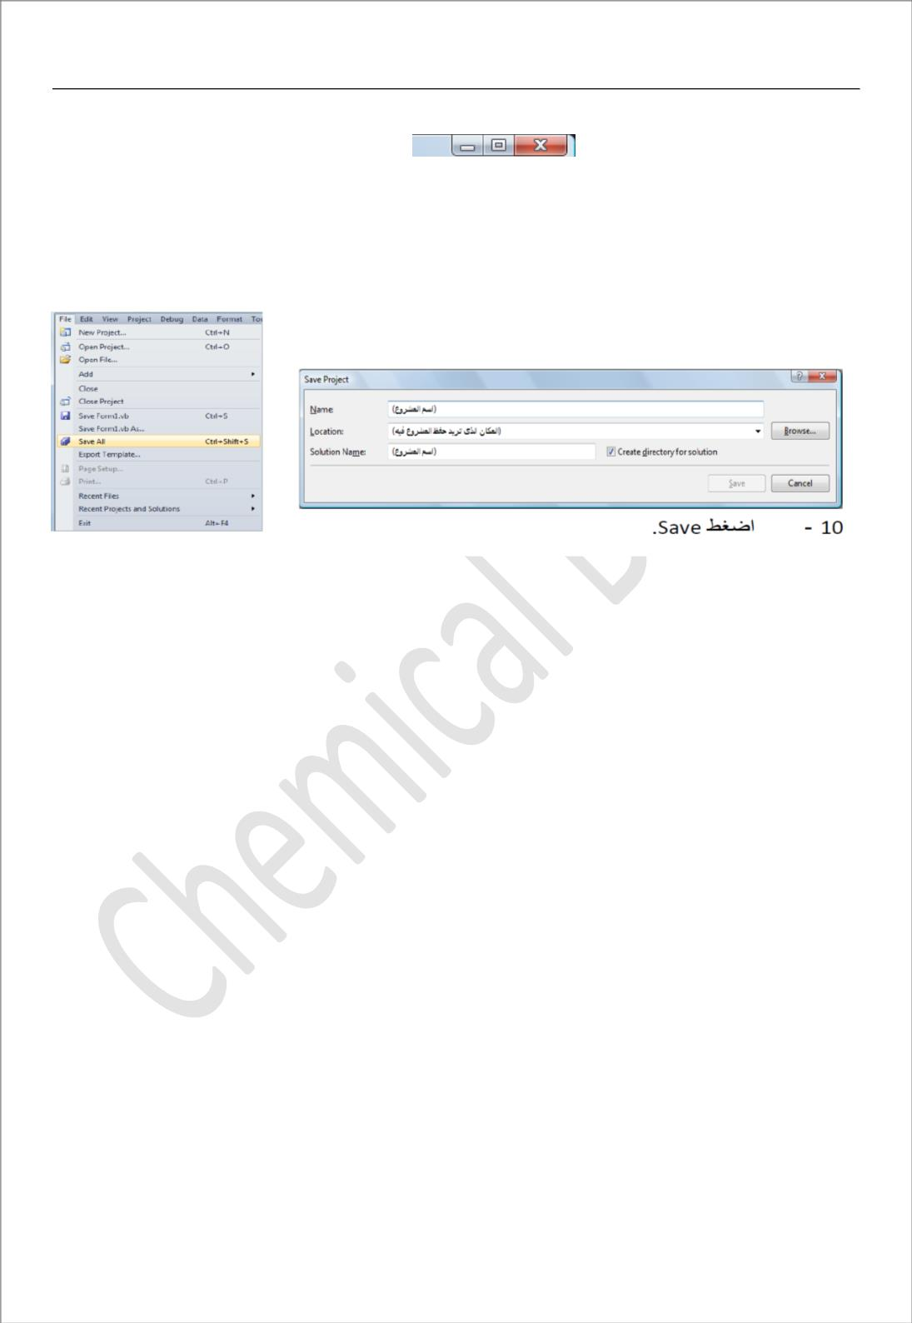
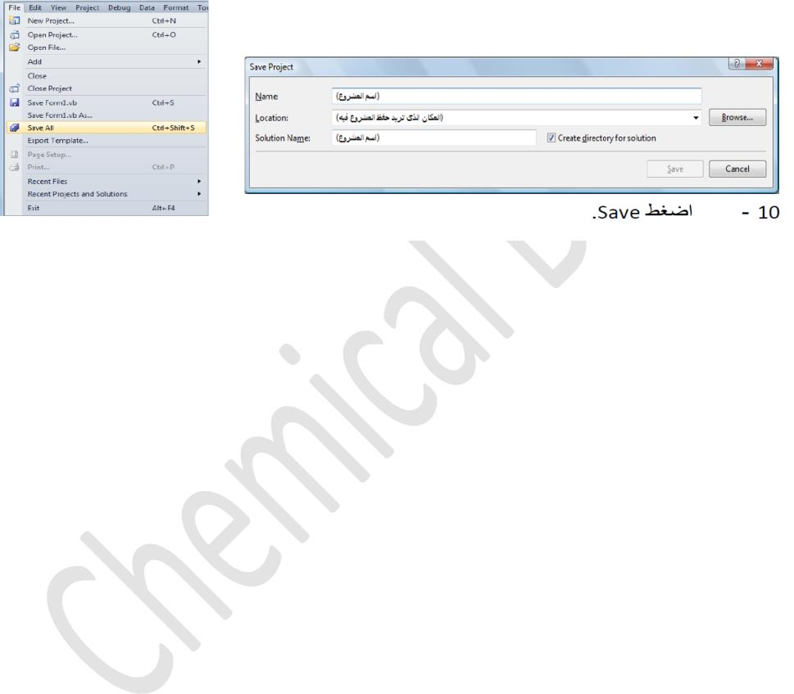
Assistant Lecturer
Visual Basic
university of Diyala /College of Engineering
Omar A. Imran
Department of Chemical
Second Class
2018 – 2019
.يمꢄتصꢃꢁ نافذة ىꢃإ ودꢂست و
X على ضغطꢁ نتهاءꢀꢁ عند و -8
File >> Save All ꢈشروꢄꢃꢁ ظꢇح نريد و جꢄبرنا ꢆأو ꢅꢄ نتهيناꢁ قدꢃ -9
Trail Version
Trail Version
Trail Version
Trail Version
Trail Version
Trail Version
Trail Version
Trail Version
Trail Version
Trail Version
Trail Version
Trail Version
Trail Version
13

Slide 4
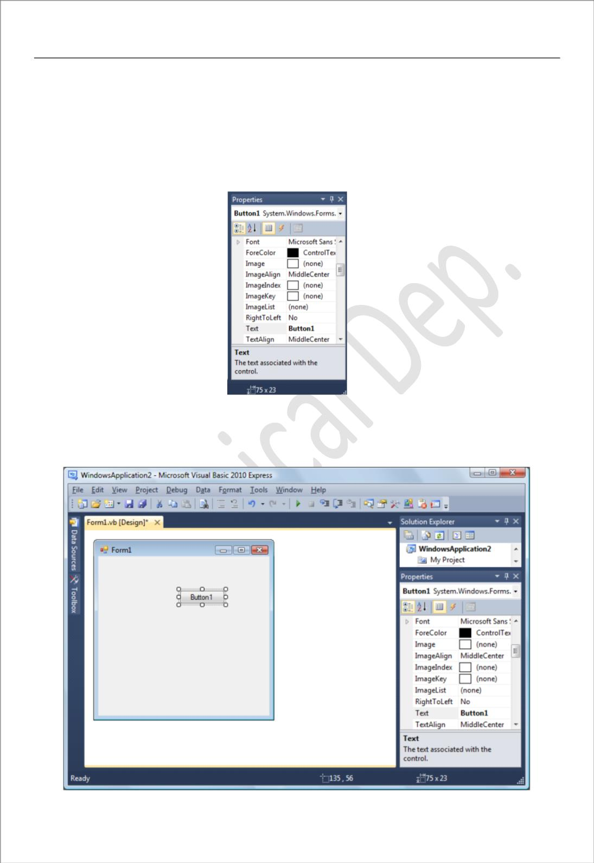
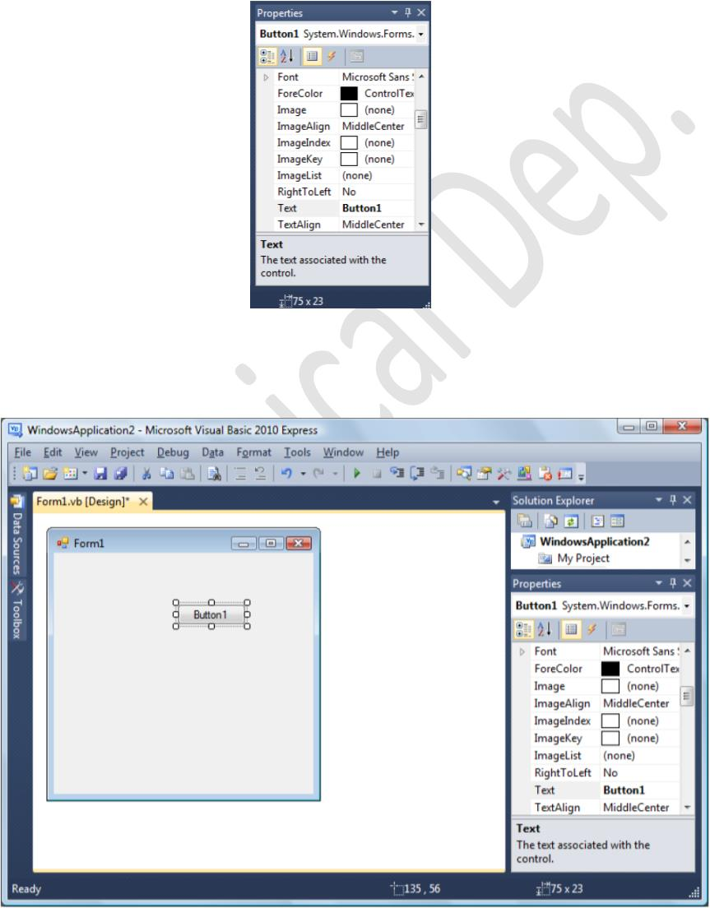
Assistant Lecturer
Visual Basic
university of Diyala /College of Engineering
Omar A. Imran
Department of Chemical
Second Class
2018 – 2019
Properties ائصꢀلخꢁ -1
ꢇꢂأد ꢆلك لمناسبةꢂ ꢄꢂدꢂعدꢅꢂ يزꢃبتج ꢁخا هو و ꢁلخصائꢂ صندوق ꢀع باختصار تحدثنا
.لمستخدمةꢂ ꢇꢂدꢍل يةꢌلشكꢂ ꢄاꢋبالص أساسا نىꢊت ꢁلخصائꢂ و ꢉلمشروꢂ ꢈف مستخدمة
Trail Version
Trail Version
Trail Version
Trail Version
Trail Version
Trail Version
Trail Version
Trail Version
Trail Version
Trail Version
Trail Version
Trail Version
Trail Version
ꢕꢊب ꢒم ꢆامꢊسنت ꢀꢔꢂ ،ꢓل بسيط كود كتابة و Button زر ꢒبوض ꢆوꢑꢂ ꢐلدرꢂ ꢈف مناꢏ دꢎل
.دꢊب فيما اꢃسنستخدم ꢈلتꢂ ناصرꢊلꢂ ꢆك ꢈف عامة تبرꢊت ꢈلتꢂ و ꢁلخصائꢂ
14

Slide 5
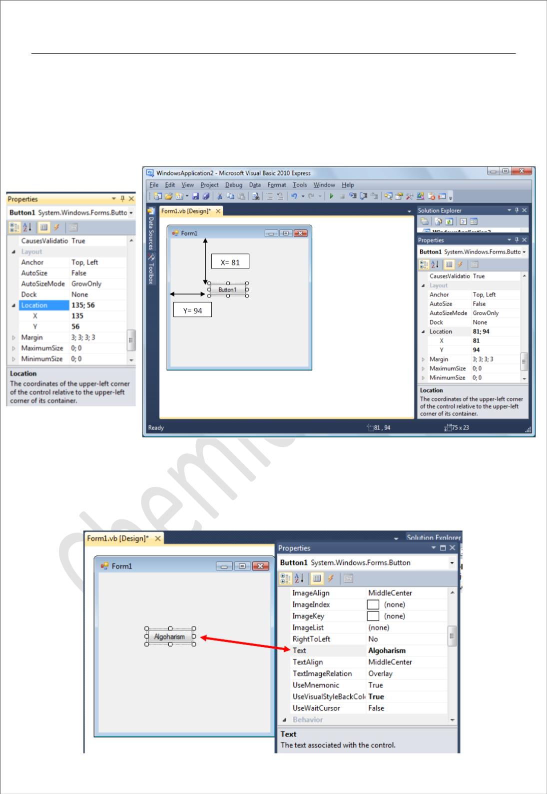
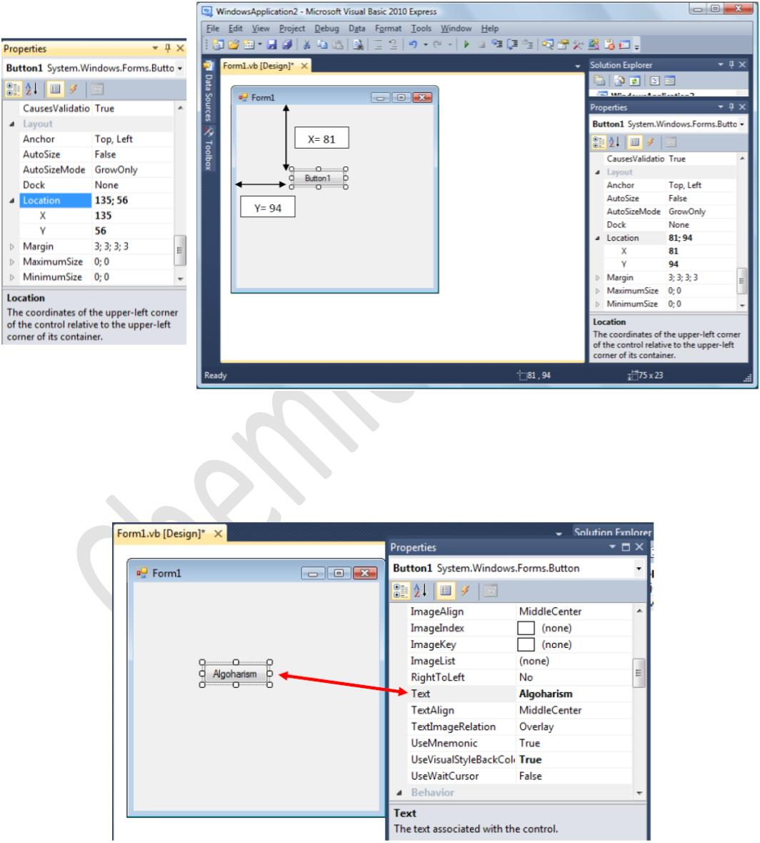
Assistant Lecturer
Visual Basic
university of Diyala /College of Engineering
Omar A. Imran
Department of Chemical
Second Class
2018 – 2019
Location الموقع -1
: نꢀتꢀꢆفر نꢀتꢀخاص من تتكونو، ꢅلمستخدꢁ صرꢄلعꢁ( مكان )ꢃموق ꢃم ꢂتتعام لتيꢁ ةꢀلخاصꢁ هي و
ظرꢄꢁ (سرꢀꢈꢁ بꢄلجاꢁ من ةꢀꢇفꢈꢁ لمسافةꢁ في ꢅتحكꢀ Y و ةꢀلرأسꢁ لمسافةꢁ ꢃم ꢂتعامꢀ x ( X وX )
.لتاليꢁ ꢂلشكꢁ
Trail Version
Trail Version
Trail Version
Trail Version
Trail Version
Trail Version
Trail Version
Trail Version
Trail Version
Trail Version
Trail Version
Trail Version
Trail Version
Text :النص- 2
.لزرꢁ ىꢋꢆ لمعرضꢁ ꢉꢄلꢁ رꢀꢀتغꢊ ꢉخا هو و
15

